Slide 1
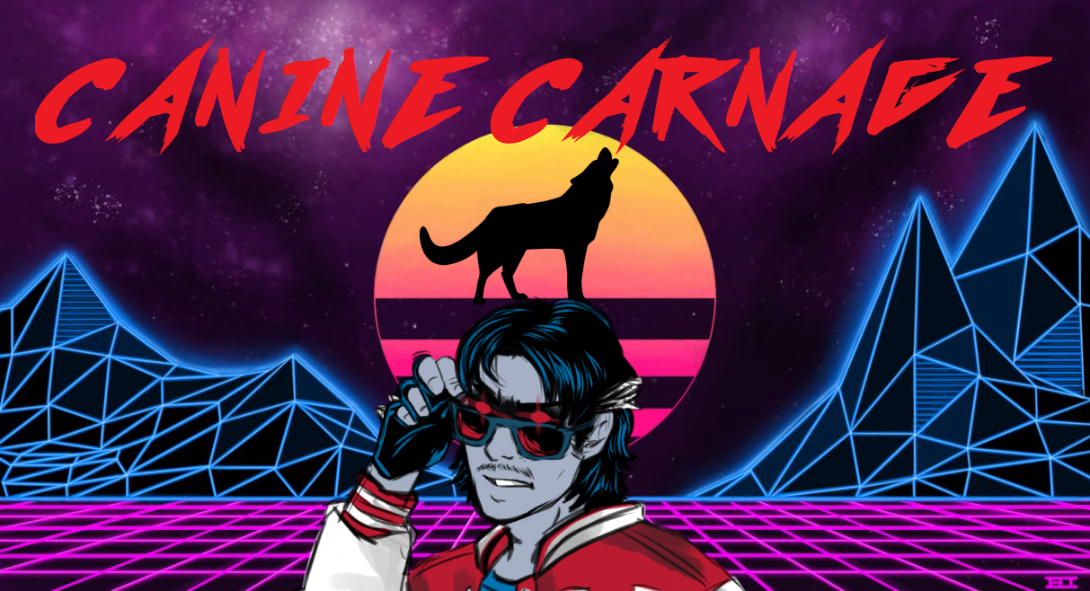

Slide 2
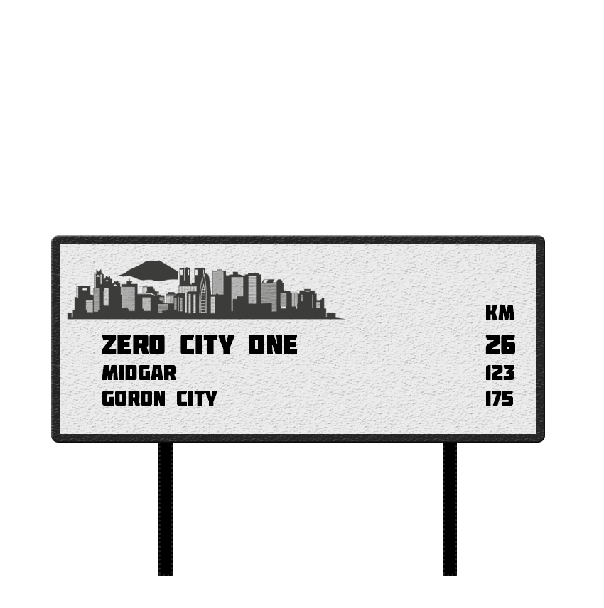
PLOT
One dog. One driver. One story.
Seeking adventure in his small, canine world, a dog travels the length of the country on a seemingly endless road. A lightning fast car jams on the breaks, almost killing our canine hero. With a driver on a mission (and happening to have two tickets to the greatest music festival of all time), the duo joins forces, setting a course for ZeroOne City.
Will this clash of worlds end well?

Slide 3
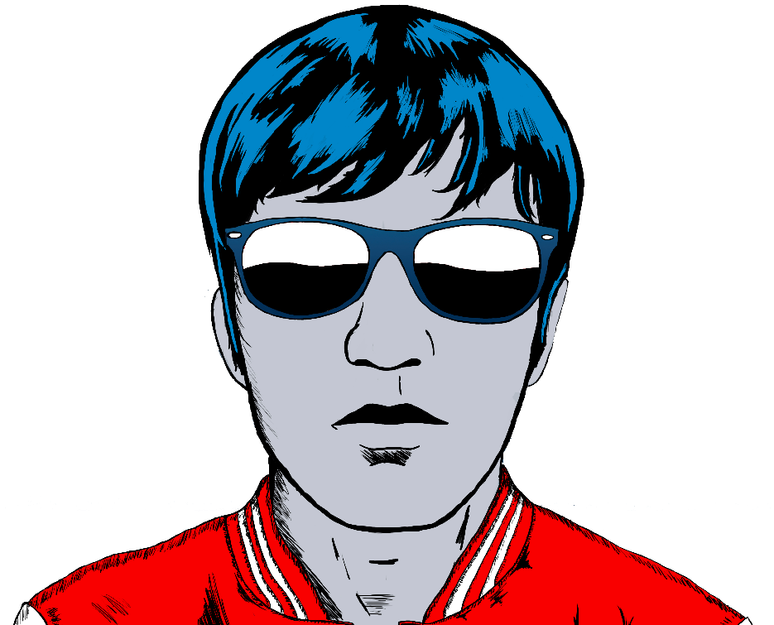

CHARACTERS
DRIVER
CANINE

Slide 4







TOOLS
INFLUENCED BY

Slide 5

Enjoy!

